Slide 1
Case Study: DGL in Fraud Detection
April Workshop Serial 3

Slide 2
Table of Contents
Fraud is everywhere
The case
Problem setting
The data
Solutions
How DGL works for fraud detection
Critical issues in Fraud detection
Wrap up
Q&A

Slide 3
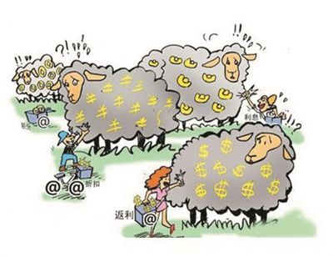
Fraud is everywhere
Finance, Healthcare, Social Security
Fraud applications/claims
Fraud accounts/Account takeover
Money laundry
In 2019, the FBI received +467,000 cybercrime complaints that caused an estimated US$3.5 billion in losses…… 2019 year saw both the highest number of complaints and the highest dollar losses on record; in 2015, losses US$1.1 billion.
Social-Media/Network
Fraud contents
Fraud behaviors
Malicious attacks
E-commerce
Fraud transactions
Unwelcome transactions
Frequent cancelations/returns

Slide 4
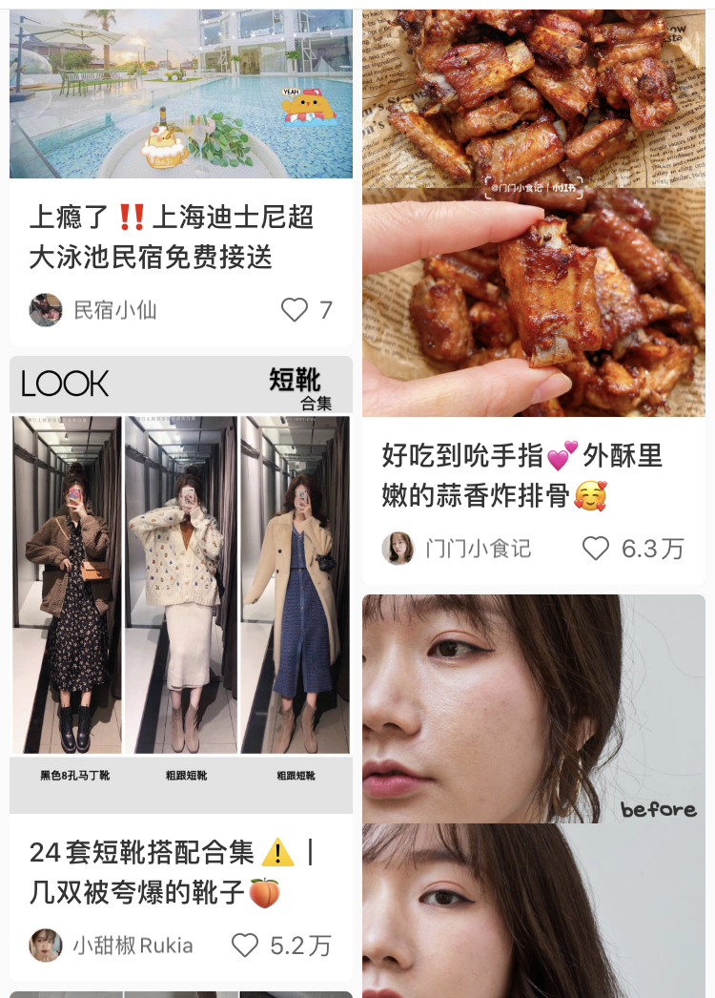
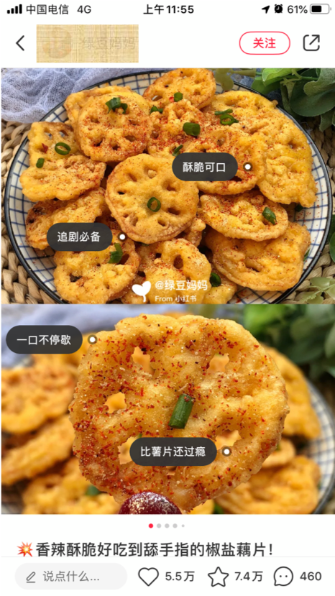
The Case Study
Background
One of the largest social life platform
User Generate Contents
Social interactions on these UGC
E-commerce channels
Potential fraudulent scenarios
Fake/illegal/misleading contents
Fake interactions
Malicious interactions
……

Slide 5
Problem Setting:
Identify Suspicious Interactions
They have internal rules to find suspicious interactions
Use ML to identify these suspicious interactions
Users can “Like”, “Collect”, “Share”, “Comment” UGCs

Slide 6
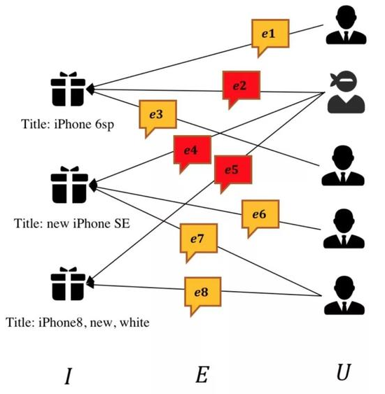
The Data
Raw Data
Two-day data of interactions (5M)
User information (90K)
UGC information (80K)
Suspicious interactions (160K)
Normal (White) User information (100K)
Labeled Data
600 labeled white, 5k labeled black users
16k labeled black interactions
UGC1
UGC2
UGC3

Slide 7
Solutions
Focus on Users
User classification
Common method
Easy to conduct
Coarse level
Hard for “gray” users
Focus on Behaviors
Interaction classification
Fine level
Handle “gray” users
Bigger data size (1-2 magnitute)
Hard for feature engineering
Suspicious users’ 1/3 interactions are suspicious
Internal rules can pinpoint suspicious interactions, but hard to tell “Normal” users

Slide 8
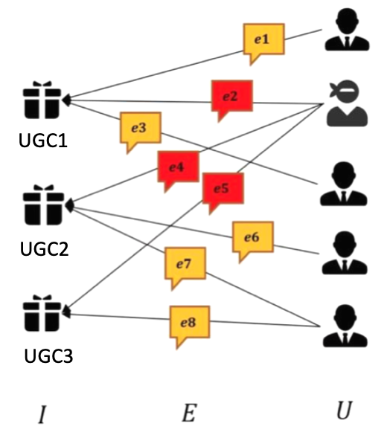
How DGL works for fraud detection
Node (User) classification
Edge (Interaction) classification
RGCN (Relational Graph Convolutional Network)
DGL has existing RGCN modules and tutorials
DGL has lower level APIs for module customization
GATN (Graph AttenTion Network)
DGL has existing GATN modules and tutorial
DGL has lower level APIs for module customization
2-layer GNN out-perform baseline models in all settings
2-layer GNN out-perform baseline models in some settings

Slide 9
Critical Issues in Fraud Detection
Evidence and Explanation
Feature Engineering vs Graph Information
Complex Ground Truth
Compare to rule-based methods, GNN needs to explain results better for action-taking.
Data and characteristics determine the upper limit of machine learning, and models and algorithms just approach this upper limit.
Easy to find “bad” samples, but hard to tell “good”. And the ratio of “good” vs “bad” is general unknow or skewed, e.g. 100:1.

Slide 10
Wrap Up
Fraud is everywhere
Social behavior create unique challenge
GNN is natural for social interaction
DGL can help with all levels
Fraud detection in real cases has unique challenges

